Slide 1



Supply Brochure
l Consulting l Turnkey projects l Supply l Electrical l Instrumentation l Civil l Mechanical l HVAC l BMS

Slide 2







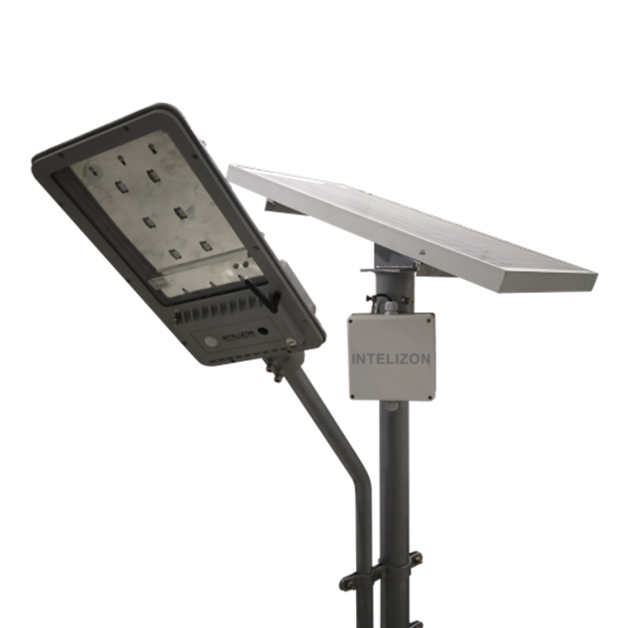
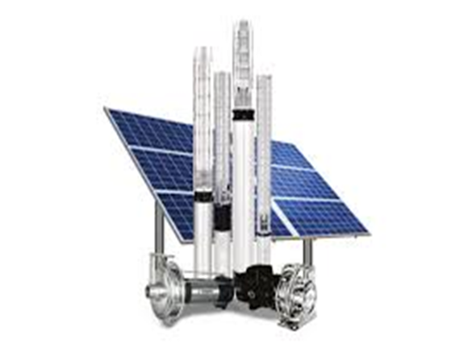
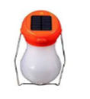
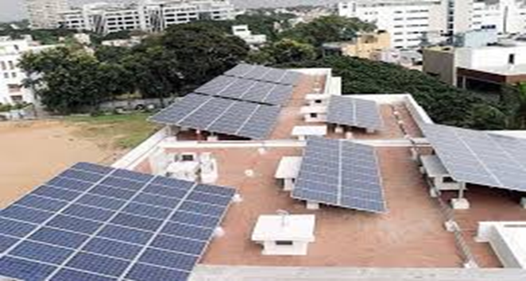
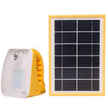
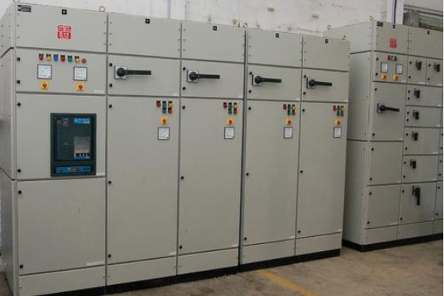

Electrical
We have an Electrical and Instrumentation team setup with vast and varied pool of experience in the Industry for more than 2 decades.
We have tied up with many Electrical/Instrumentation product suppliers who are renowned in the industry. We provide support right from selection of the products to installation to suit your needs and requirements. With our technical expertise you can rest assured of best product quality and services for the same.
LT Switchgear : Schneider, ABB, L & T and Legrand
Cables : Polycab, RPG, KEC and Varsha
HT switchgear and Panels : Schneider and ABB
LT panels : Schneider, ABB and L & T
Compact HT panels : Schneider
UPS Systems : Schneider, Emerson and cosmic
Transformers up to 33 KV : Schneider, Trinity Electricals
Optical fiber cables : West coast Opti links
LED lighting : NTL –Lemnis, OSRAM, Victron
Flameproof switchgear : Shreya- Extech, Pluto, Standard
Energy management system : Schneider and L & T
Solar Power systems : Orb Energy, Infy Energy, Arushi
Solar Irrigation Systems : Infy Energy, Amruth Systems
Solar Lights & CCTV system : Intellizon (Wifi systems with no cabling)
Solar AC and DC inverters : Intellizon
Solar Micro lighting : Intellizon, Compac, D light, Reap
Motors : SIEMENS, Crompton greaves, EESL
GI ladder cable trays, perforated cable trays and GI flats
GI and MS Conduits, PVC and HDPE pipes
All Electrical measuring and safety equipment

Slide 3









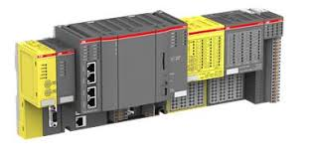

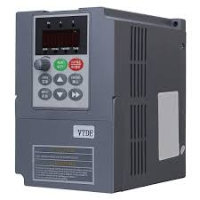
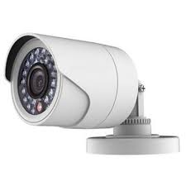
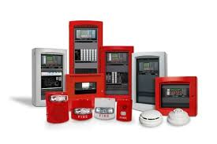

Instrumentation and BMS
Measuring instruments : Radix, Emerson
PLCs : SIEMENS, Allen Bradley, Schneider
VFD’s and soft starters : SIEMENS, Allen Bradley, Delta
Analog gauges : Radix
Gas monitoring systems : Honeywell
Door interlocking and access : Honeywell, Styrax
Fire alarm system : Morley, GST, cooper
BMS : Honeywell, Johnson controls
Public addressing system : Custom built
CCTV solutions : Hikvision, Honeywell
Home &Office Automation : Panasonic, Honeywell, ABB, Fibaro
EPABX systems : Custom built, any make
Large and small display solutions,
Projectors for homes and offices, Audio Video solutions
DEALERSHIP
We are authorized dealers for MTI (Metal Tubes India) through which we supply Wao-loc make Instrumentation pipes, tubes and fittings. Some of the products in the range available are as below
Instrumentation SS male and female connector/Union/Tee/Elbow/long reducer/port connection size 1/8” -1” (Inch), 3 mm -25mm (Metric)
Wao- Loc make Instrumentation valves like needle valve/Ball valve/Bleed valve from size 1/8” – 2”
Wao-Loc make Instrumentation manifolds 2 way manifolds/3 way manifolds/5 way manifold (Straight/Angle/Extended/T/ H types)
Air manifolds and condensate pots, size 1/2 “- 6”
Wao- Loc make Thermowells, Straight/Taper/Vertical from size 1/4 “ – 4”
Brass tube fittings like male connector/Female connectors, Union/Bulkhead Unions/Elbows/Tees/Reducer size1/4 “ – 1”
Brass and copper tubes, Straight/coil form with sizes 1/8 “ – 4”

Slide 4

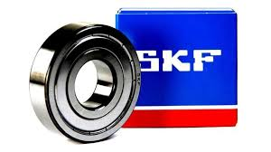




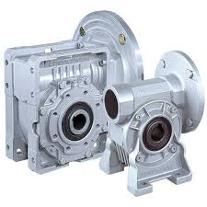
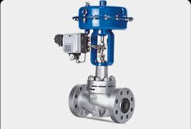
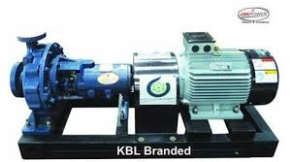
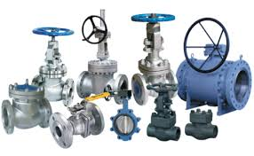
Mechanical
Bearings : FAG and SKF
Tools and tackles : Stanley
CPVC pipes and fittings : Astral, Supreme
Pipes : MS and SS
Clean room SS fittings : Custom built as per drawings
Gear boxes : Bonfiglioli, Shanti Gear boxes
Valves with actuators : Audco, Valco, Aeri, Samson
Pumps : Kirloskar, Wilo Mather and platt, Grundfos
Glass enclosures : HAFELE
Fittings : All types of pipe fittings like Flanges , elbows,
ball valves , nut & bolts in MS & SS
DEALERSHIP
We are authorized dealers for MTI (Metal Tubes India) for the southern region in
India. MTI is a known brand for ferrous and non-ferrous metal tubes and pipes.
Some of the products in the range available are as below
Seamless/ ERW tubes in SS/CS/AS/DS/NS MOC with size 1/8” OD – 2” OD
Seamless/ERW/EFW pipes in SS/CS/AS/DS/NS MOC with size 1/2 “ NB – 48 “ NB
Wao- Loc make Thermowells, Straight/Taper/Vertical in SS/CS/AS/DS/NS MOC from size 1/4 “ – 4”
Monoflange Double block and bleed valves in SS/CS/AS/DS/NS MOC with size15 NB-150 NB (Flanged end) and 8 NB-50 NB (Threaded end)
Butt weld fittings: Elbow T, Reducer, cross, stub end in SS/AS/SS/DS/NS MOC size 1/2 “- 48 “ NB
Forged fittings: Weld-neck, slip-on, Lap joint, Socket weld, Elbows, Cross, Tees, couplings, Caps 1/2 “ -4”
SS/CS/AS/DS/NS Flanges 1/2 “ – 24”, weldneck/Blind/Slipon/Flat face/threaded and others
SS/CS/AS/DS/NS Gate/Globe/Check/Manifold type/Y type/Angle valves from size 1/2 “ NB – 48” NB

Slide 5
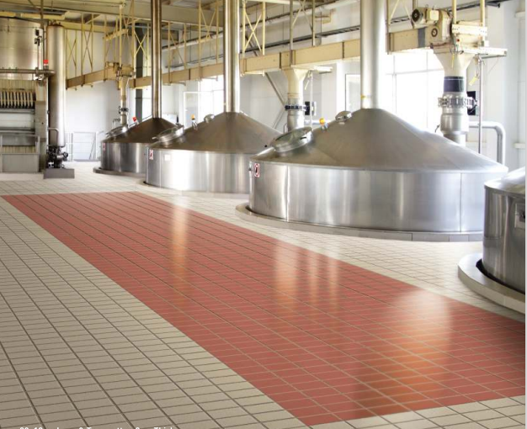

Civil – Industrial AR Tiles
Worried about Vrooming forklifts, thumping of machines, extreme temperatures, occasional spillage of liquids, oil or acids, continuous heavy pedestrian and hard wheeled trolley traffic?
Designed to withstand extreme demands of process and manufacturing industries
One Stop Solution:
Industrial Tiles Features:
Higher breaking strength
1.2 cm : > 2500 N, 1.5 cm : > 4000 N, 2 cm: > 7500 N
High scratch Resistance Mohs Hardness >7
High abrasion resistance, deep abrasion volume
Loss < 144 cu.m
Matt Finish Skid Resistance floor – Coefficient of Friction> 0.6
Stain Resistance
Low water absorption < 0.5%
Very high shear resistance
Resistance to heavy duty hard wheel
trolley movement
Fire proof
Low maintenance cost
Service life 10 years
Low Shade variation
Acid and Alkali resistant : As per IS: 4457 and EN/ASTM/DIN and ISO Standards. Confirms to ISO 18001 and ISO 14001 regulations
Indestructible and highly durable
Anti skid / Anti static
Applications
Pharmaceutical, food and Buldkdrugs,
Automobile, Air hangars, Chemical Industry
Electronic Industries, Power plants, Breweries,
Petrochemicals, Workshops, Warehouses,
Labs, dispatch areas

Slide 6
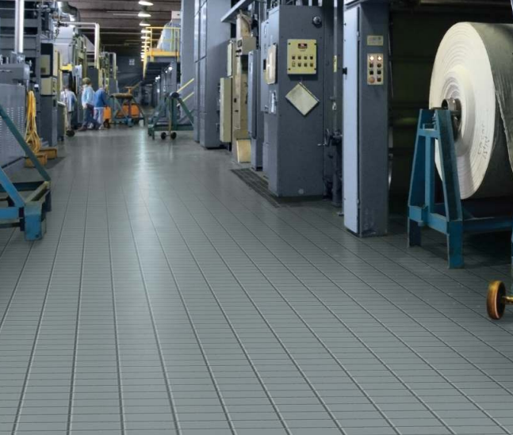
Civil – Industrial AR Tiles
ELCIMECHS PVT LTD is dealer for Johnson Endura AR tiles for Hyderabad/ Telangana region.
Tiling/ Flooring/ Water proofing solutions and services provided across India
Sizes Available:
Industrial AR Tiles
Plain series 30 x 30 cm – 1.2 cm thick
Color series 30 x 30 cm – 1.2 cm thick
Textures Series 30 x 30 cm – 1.2 cm thick
Plain series 20 x 10 cm – 1.2 cm thick
Plain series 30 x 30 cm – 1.5 cm thick
Plain series 20 x 20 cm – 1.5 cm thick
Plain series 20 x 10 cm- 1.5 cm thick
Plain series 30 x 30 cm – 2 cm thick
Plain series 20 x 10 cm – 2 cm thick
Anti static series
30 x 30 cm – 1 cm thick
Meteor collections
60 x 60 cm – 1.5 cm thick
60 x 60 cm – 2 cm thick
Antistatic Tiles
Anti static dissipative type: (Surface resistance between 1 M ohm to 1 G ohm)
Anti static conductive type: (<1 Mega ohm) with static decay time < 0.5 sec
Anti- static tiles remove static electricity charge from the surface of tile and earth it and hence the fire hazard is minimized.
Application areas : Server rooms,, fire prone areas, Computer rooms, Electronic equipment rooms, PLC panel rooms, PCB manufacturing , IT industry, sophisticated Equipment Laboratories, Shell making factories, Defense factories, Hospital Operation theatres
Endura Meteor
With 1.5 cm and 2 cm thickness.
Perfect for gardens, pathways, swimming pool decks, varandah/porches, public places and corridors and are alternative to standard flooring like concrete tiles, paver blocks, natural stones etc making it best choice of outdoor usage.
Features do not diminish with passage of time
Pricing and details available at request : info@elcimechs.com

Slide 7
Contact details
Registered Office :
BM Habitat Mall,2nd floor
Jayalakshmipuram, Mysore
Karnataka – 570012
Branch Office – Bangalore :
# 22, Prabhava Nilaya, Teachers colony,
1st stage, 2nd block, 7th cross, JSS school
Road, HBR layout, Bangalore 560043
Branch Office – Hyderabad
H. No : 6-10-109/59, A.V. Balanagar
Area, BBR Hospital backside,
Vinayak Nagar, Medchal Madal,
Hyderabad - 500042
Website : www.elcimechs.com
Email : info@elcimechs.com
GST No : 29AAFCE8578B1ZC
Thank you

